Slide 1
Filter

Slide 2
Filter
Form:
filter(function, list)
example
list = [1, 2, 3,4,5]
filtered_list = filter(lambda x : x > 3, list)

Slide 3
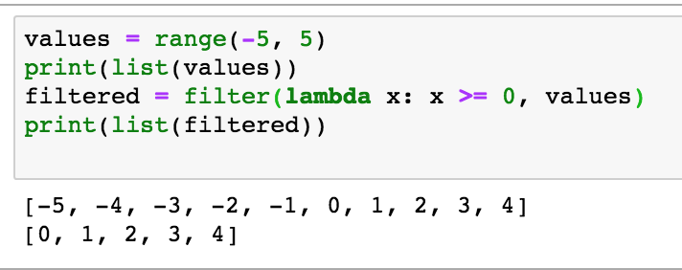
Simple Example

Slide 4
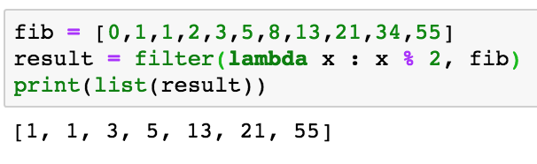
Another Example Fibonacci

Slide 5
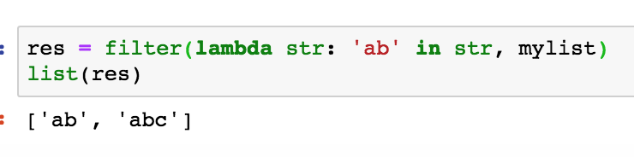
Filter with Strings

